Slide 1
Tele-Medicine, Tele-Consultation Solutions Welcome to the Future …
Lifeline Telemedicine Suite
MousuQun Global Nigeria
++234 7012950008
business@mousuqun.com

Slide 2
Lifeline Telemedicine Suite provides a Single Platform for Real-time Integrated Clinical workflows with Audio Video Capability with Operational & Business workflows for qualitative and quantitative patient Interactions in todays virtual world.
Our Tele-Medicine and Tele-Consultation solutions bring patients virtually to your clinicians helping you make clinical assessment, decisions and facilitating faster diagnosing, and as a result, improving patient outcomes.
We help you bridge the gap between your Clinicians and your patient like they you right in person by integrating technology and clinical tools in todays dynamic and connected world.
Web Based
Multiple Workflow Supported
Scalable
Enterprise Ready
Audio Video Interface
Cloud Ready
On Premise
Single
Center
Multi Center Capability
Patient Portal
Call Center Workflow
Web Portal Registration
Multi Device
Secure
No Application Required
Payment Gateway Integration
Credit Card
Mobile
Laptop & Desktop
Patient Communication
HTTS
SSL
Debit Card
Android
Windows
SMS
WhatsApp
Email
HIPPA Complaint
Encrypted
IOS
MAC

Slide 3
Lifeline Telemedicine Workflow …

Slide 4
Workflow for our Tele-Medicine Suite
Seamless Patient Engagement & Clinical Management
Hospital Call Center
Hospital
Multiple Workflows
Supported
Call Center Operations / Screening Team
Virtual Doctor Consultation
Initial Screen performed
Identified for COVID or Other Consultation
Demographic, Symptoms captured
Doctor Connect to Patient via Tele-Consultation with Audio & Video Interaction
Verifies the Clinical assessment by with Patient
Adds/Updates symptoms
Suggest investigation (Lab, etc) Records Diagnosis, Advices Prescription
Clinical Documentation completed in system for future reference
Patient Portal
Call’s a Toll Free phone No of the hospital and starts as interaction
Call Center Workflow
Access Current Consultation Noted & Summary in Real Time
Access Old Visit Details
Access Prescriptions & Clinical Documents
Access Future Appointment Schedules
Request for New Appointment
Tele Consultation Appointment Date & Time with Doctor Confirmed
SMS & Email Conformation Sent to Patient with Link of the message
Payment workflow Complete
Yes
Visits the Patient Portal using a laptop/mobile and self Registers for a Virtual Visit
Self Registration
for New Patient
Online Availability of Doctors Seen by Patient
Request for a Online Tele-Consultation
Web Portal Workflow
Patient Portal
Patient Portal
Patient
Call Center
Screen Team
Doctor

Slide 5
Solution Features - For Call Center Team - For Clinical Team - For Patient

Slide 6
Call Center – Patient Registration
For Call Center Team
Call Center / Tele Operator Login
Patient Registration
Minimum field for Patient Registration
Preferred Mode of Consultation – Audio, Video or Both
Web Based Login Screen with Role based Access
Shortcut for COVID Screening, General Screening and Appointment Booking on Landing Screen

Slide 7
Call Center – Role Based Worklists
For Call Center Team
User Role Based Worklists
Pending Worklists
Completed Worklist
Quick Patient Search on MRN / Phone No.
Date Range Filters
Access to Screening Data
Call Center - Appointment List View
Color Coded Status
Payment Details Status
Cancellation Details

Slide 8
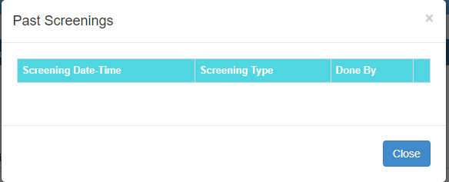
Call Center – COVID Screen Form
For Call Center Team
Configurable COVID Screen Form
Flexible to Meet Regional Compliance
Role Based Access to COVID Form
Capture Patient History During Screening
Assessment Seen by Doctor during Tele-Consultation
Data Security & Integrity
Shortcut for Appointment Booking
Shortcut to see previous assessments

Slide 9
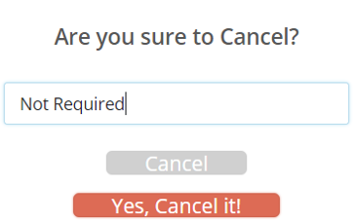
Call Center – Appointment Features
For Call Center Team
Flexible Appointment Management
Overall visibility and Efficient Clinical Team Management
Temporary/Appointment Booking Workflow
Complete Visibility of Doctor Availability | as per Department, Specialty
Appointment Cancellation & Integrated Refund
Built-In Roster Management
Applicable Charges as per Rate Chart
Base Charge & Applicable Taxes Breakup
Resend SMS & Email Option

Slide 10
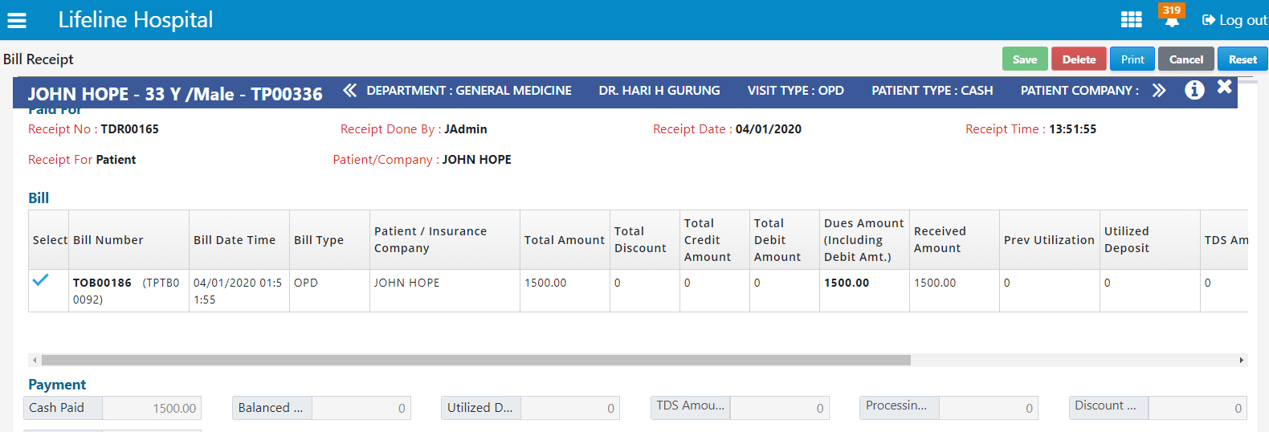
Call Center – Payments & Refunds
For Call Center Team
Receipt Generation Post Payment
Receipt Generated post successful Payment
Automatic Email Receipts to Patient
Payment Stats reflects on User Worklist
Failed Payment Tracking Worklist
Complete Visibility of Doctor Availability | as per Department, Specialty
Refund Approval & Receipts
Refund Approval Process
Authority Based Approval
Refund Receipt Generation

Slide 11
Clinical Team – Doctor
For Clinical/Doctor Team
Clinical Team / Doctor Login
Doctor Dashboard
Responsive Design Interface – Desktop, Tablet
Quick Summary – Todays Appointment, Waiting
My Worklist – Patient Registered under me
Canned Queries for – Date & Status
Color Coded Patient Status
Web Based Login Screen with Role based Access
New & Follow-Up patient Identification
Access from Desktop or Tablet
Real Time Status of Video Link
Auto-Integration with Inbuilt Webcam and Mic
Join Call Button – For each Patient

Slide 12
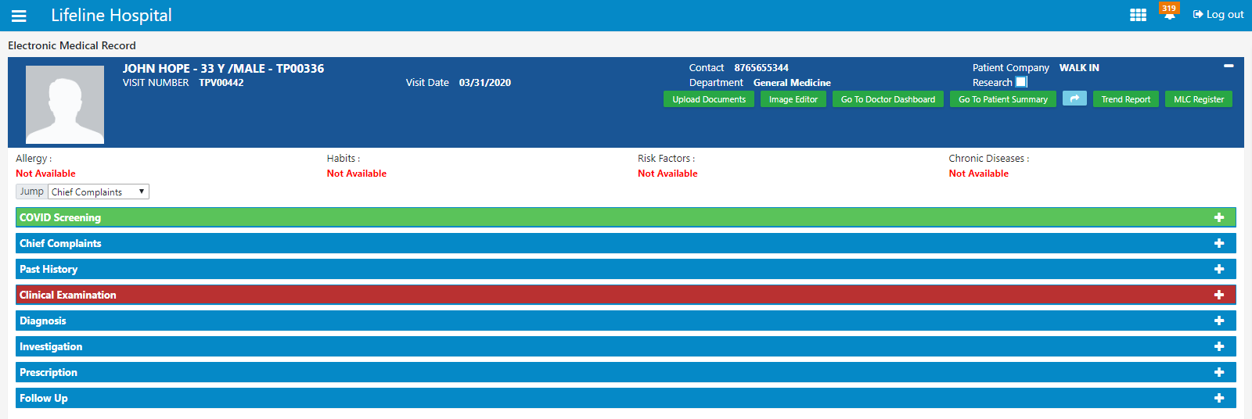
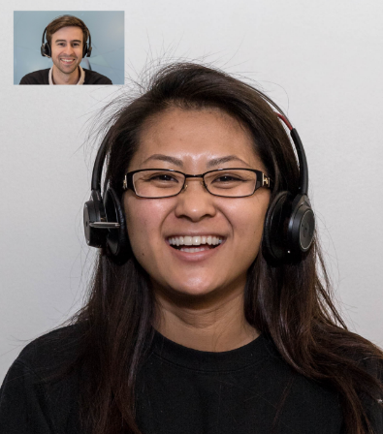
Clinical Team – Doctor
For Clinical/Doctor Team
Doctor EMR
Complete Clinical Patient Management
Access to COVID Screening Form
Embedded Patient Video View
Role Based Access to various Sections of EMR
Review Patient Current / Historical Summary
AV Control – Mute & Reconnect
Record / Review Patient History
Record Suggest Investigations
Supported on Desktop & Tablet
Record Prescriptions
Record Diagnosis
Low Bandwidth Requirements

Slide 13
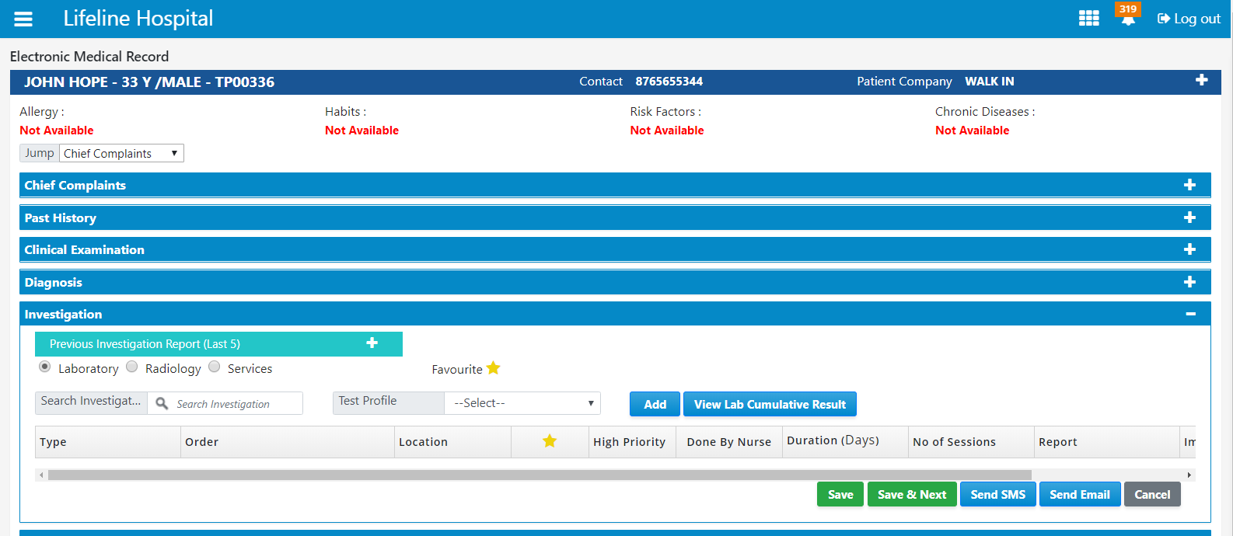
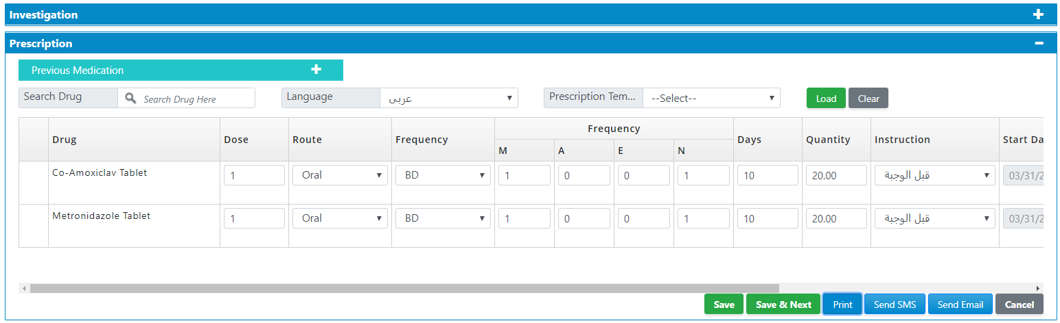
Clinical Team – Doctor
For Clinical/Doctor Team
Clinical Record – Investigations
Suggest / Record Investigations
Configurable Lab Investigations
Configurable Other Services
Clinical Record – Prescriptions
Record Prescriptions
Record Frequency & Quantity
Configurable Patient Instructions
Multi-Language Instructions for Prescriptions

Slide 14
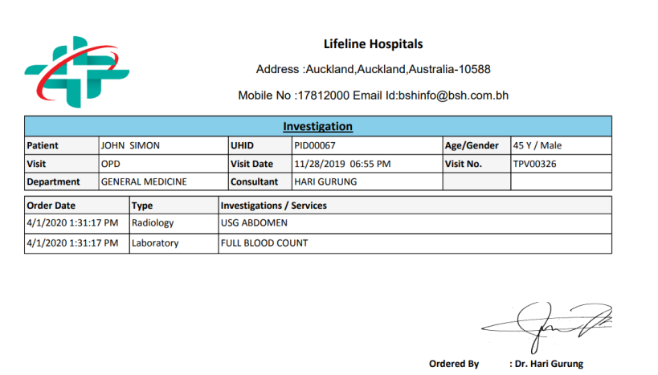
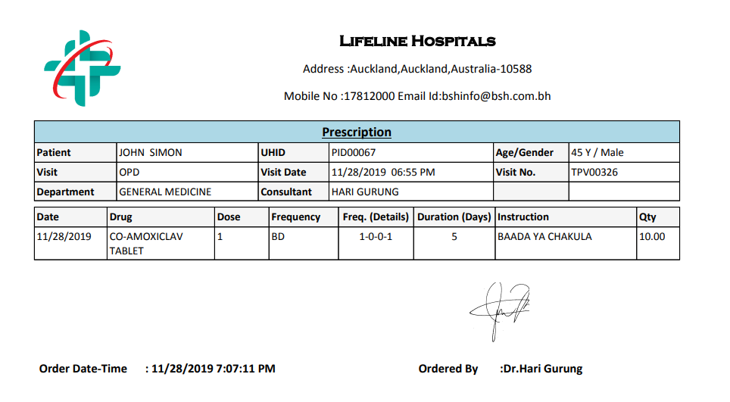
Patient – Patient Registration
For Patients
Tele-Consultation View
From Patient Portal
Welcome John Hope
Welcome John Hope
Access from Phone or Desktop
Any time Access to EMR Summary
Please wait while Dr. Peter joins you!
Current and Future Appointments
Complete Access to Entire Clinical Record
Access from Laptop, Table or Mobile
Investigations & Prescriptions on Patient Portal
Mute
End Call
Mute
End Call
Any Mobile Support – Android or IOS
Access from Desktop or Tablet
Low bandwidth Requirements

Slide 15
Summary

Slide 16
Summary - Lifeline Telemedicine Suite
Enterprise Telemedicine Platform
COVID
Scalable & Secure
Global Compliance
Device Agnostic
Multiple Workflow
Clinical workflow & AV Integration
Ready
Cloud & On-Prem
HIPPA Compliant
Mobile, Table, Desktop
Call Center / Patient Portal
For Healthcare Providers
For Your Patients
We are Ready Now to make your Clinical Practice Virtual
Anytime Anywhere Access to your Doctor
Simple Seamless Deployment
Easy & Efficient than going to a Hospital
Our Value Add
Cost Effective & Convenient
Access to Affordable & Quality Healthcare
Increased Access to Healthcare
Secure & Safe Virtual Consultations
One Stop Solution for Clinical & Operational Outcomes
My Hospital is Always Available for Me 24X7
Single Platform for Virtual Health Requirements
Minimal Exposure to Clinically Risky Environments
New Business Model & New Patient Inflows

Slide 17
Thank You !!!

